Slide 1
Lecture 8 - Motivation
Managing Business

Slide 2
Learning Outcomes
At the end of the lecture, you should be able to:
  Define motivation.
  Explain motivation as a need-satisfying process.
  Discuss early Theories of Motivation
  Explain and contrast contemporary Theories of Motivation

Slide 3
What Is Motivation?
Motivation
  Is the result of an interaction between the person and a situation; it is not a personal trait.
  Is the process by which a person’s efforts are energised, directed, and sustained towards attaining a goal.
    Energy: a measure of intensity or drive.
    Direction: toward organisational goals
    Persistence: exerting effort to achieve goals.
  Motivation works best when individual needs are compatible with organisational goals.

Slide 4
Early Theories of Motivation
Maslow’s Hierarchy of Needs
MacGregor’s Theories X and Y
Herzberg’s Two-Factor Theory

Slide 5
Early Theories of Motivation
Maslow’s Hierarchy of Needs Theory
  Needs were categorised as five levels of lower- to higher-order needs.
    Individuals must satisfy lower-order needs before they can satisfy higher order needs.
    Satisfied needs will no longer motivate.
    Motivating a person depends on knowing at what level that person is on the hierarchy.
  Hierarchy of needs
    Lower-order (external): physiological, safety
    Higher-order (internal): social, esteem, self-actualisation

Slide 6
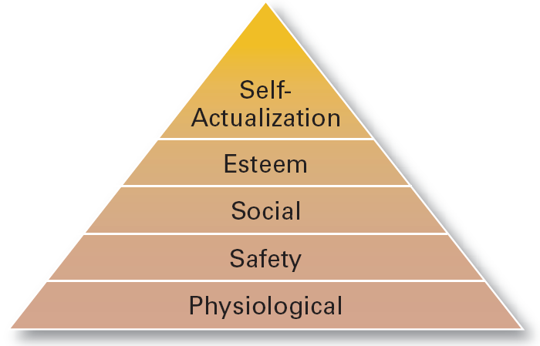
Maslow’s Hierarchy of Needs

Slide 7
Early Theories of Motivation (cont’d)
McGregor’s Theory X and Theory Y
  Theory X
    Assumes that workers have little ambition, dislike work, avoid responsibility, and require close supervision.
  Theory Y
    Assumes that workers can exercise self-direction, desire responsibility, and like to work.
  Assumption:
    Motivation is maximised by participative decision making, interesting jobs, and good group relations.

Slide 8
Early Theories of Motivation (cont’d)
Herzberg’s Motivation-Hygiene Theory
  Job satisfaction and job dissatisfaction are created by different factors.
    Hygiene factors: extrinsic (environmental) factors that create job dissatisfaction.
    Motivators: intrinsic (psychological) factors that create job satisfaction.
  Attempted to explain why job satisfaction does not result in increased performance.
    The opposite of satisfaction is not dissatisfaction, but rather no satisfaction.

Slide 9
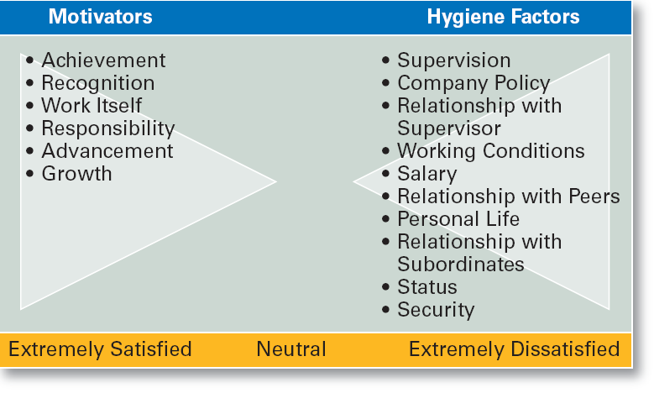
Herzberg’s Motivation-Hygiene Theory

Slide 10
Contemporary Theories of Motivation
Three-Needs Theory
Goal-Setting Theory
Reinforcement Theory
Equity Theory
Expectancy Theory

Slide 11
Motivation and Needs
Three-Needs Theory (McClelland)
  There are three major acquired needs that are major motives in work.
    Need for achievement (nAch)
      The drive to excel and succeed
    Need for power (nPow)
      The need to influence the behavior of others
    Need of affiliation (nAff)
      The desire for interpersonal relationships

Slide 12
Motivation and Goals
Goal-Setting Theory
  Proposes that setting goals that are accepted, specific, and challenging yet achievable will result in higher performance than having no or easy goals.
  Is culture bound to the U.S. and Canada.
Benefits of Participation in Goal-Setting
  Increases the acceptance of goals.
  Fosters commitment to difficult, public goals.
  Provides for self-feedback (internal locus of control) that guides behavior and motivates performance (self-efficacy).

Slide 13
Motivation and Behavior
Reinforcement Theory
  Assumes that a desired behavior is a function of its consequences, is externally caused, and if reinforced, is likely to be repeated.
    Positive reinforcement is preferred for its long-term effects on performance
    Ignoring undesired behavior is better than punishment which may create additional dysfunctional behaviors.

Slide 14
Motivation and Perception
Equity Theory
  Proposes that employees perceive what they get from a job situation (outcomes) in relation to what they put in (inputs) and then compare their inputs-outcomes ratio with the inputs-outcomes ratios of relevant others.
    If the ratios are perceived as equal then a state of equity (fairness) exists.
    If the ratios are perceived as unequal, inequity exists and the person feels under- or over-rewarded.
    When inequities occur, employees will attempt to do something to rebalance the ratios (seek justice).

Slide 15
Motivation and Perception (cont’d)
Equity Theory (cont’d)
  Employee responses to perceived inequities:
    Distort own or others’ ratios.
    Induce others to change their own inputs or outcomes.
    Change own inputs (increase or decrease efforts) or outcomes (seek greater rewards).
    Choose a different comparison (referent) other (person, systems, or self).
    Quit their job.
  Employees are concerned with both the absolute and relative nature of organisational rewards.

Slide 16
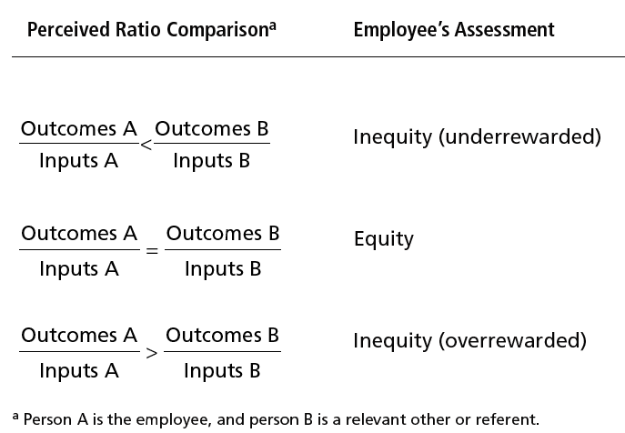
Equity Theory

Slide 17
Motivation and Perception (cont’d)
Equity Theory (cont’d)
  Distributive justice
    The perceived fairness of the amount and allocation of rewards among individuals (i.e., who received what).
      Influences an employee’s satisfaction.
  Procedural justice
    The perceived fairness of the process use to determine the distribution of rewards (i.e., how who received what).
      Affects an employee’s organisational commitment.

Slide 18
Motivation and Behavior
Expectancy Theory (Vroom)
  States that an individual tends to act in a certain way based on the expectation that the act will be followed by a given outcome and on the attractiveness of that outcome to the individual.
  Key to the theory is understanding and managing employee goals and the linkages among and between effort, performance and rewards.
    Effort: employee abilities and training/development
    Performance: valid appraisal systems
    Rewards (goals): understanding employee needs

Slide 19
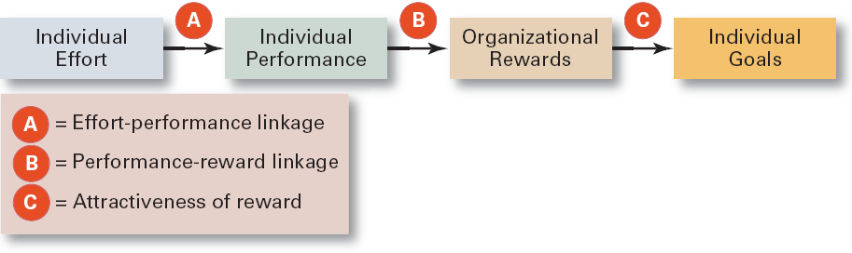
Simplified Expectancy Model

Slide 20
Motivation and Behavior (cont’d)
Expectancy Relationships
  Expectancy (effort-performance linkage)
    The perceived probability that an individual’s effort will result in a certain level of performance.
  Instrumentality
    The perception that a particular level of performance will result in the attaining a desired outcome (reward).
  Valence
    The attractiveness/importance of the performance reward (outcome) to the individual.

Slide 21
From Theory to Practice:
Guidelines for Motivating Employees
Use goals
Ensure that goals are perceived as attainable
Individualise rewards
Link rewards to performance
Check the system for equity
Use recognition
Show care and concern for employees
Don’t ignore money

Slide 22
Summary of Main Teaching Points
  Describe the three needs McClelland proposed as being present in work settings.
  Explain how goal-setting and reinforcement theories explain employee motivation.
  Discuss the motivation implications of equity theory.
  Explain the three key linkages in expectancy theory and their role in motivation.

Slide 23
Question and Answer Session
Q & A

Slide 24
Next Session
Topic and Structure of next session
NEXT LESSON:
Leadership

